Slide 1

Investment Analysis of Emerging Markets
Balancing Risk and Return for Optimal Investment Choices
Prepared by: Adrian Moroianu
Date: 5/20/2024

Slide 2
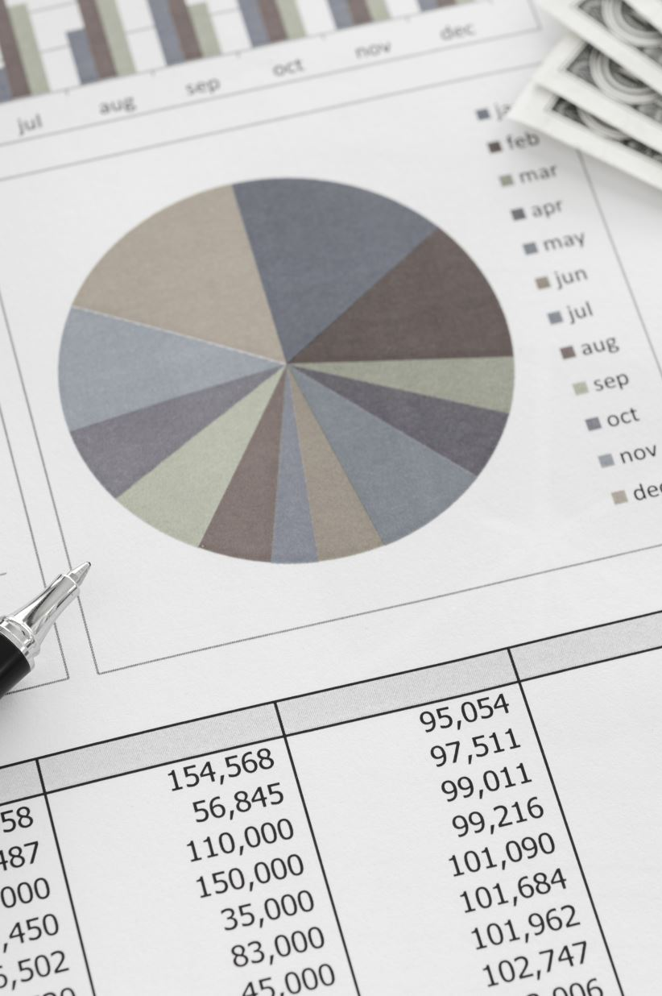
Introduction
Objective: To analyze and compare the investment potential of various emerging markets based on expected returns and associated risks.
Key Metrics: Future value of a €10,000 investment over 5 years, credit ratings as risk indicators.

Slide 3

Data Assumptions
We'll use the average GDP growth rates for the next 5 years:
Safe Countries:
- United States: 2.0%
- Germany: 1.5%
- Switzerland: 1.5%
- Norway: 2.0%
- Australia: 2.5%
Emerging Countries:
- India: 7.0%
- Brazil: 2.5%
- Indonesia: 5.5%
- Mexico: 3.0%
- Vietnam: 6.5%

Slide 4

Calculating Future Value
The formula to calculate the future value of an investment is:
FV = PV × (1 + r)^n
Where:
- FV is the future value of the investment.
- PV is the present value of the investment (€10,000).
- r is the annual growth rate.
- n is the number of years (5 years).

Slide 5
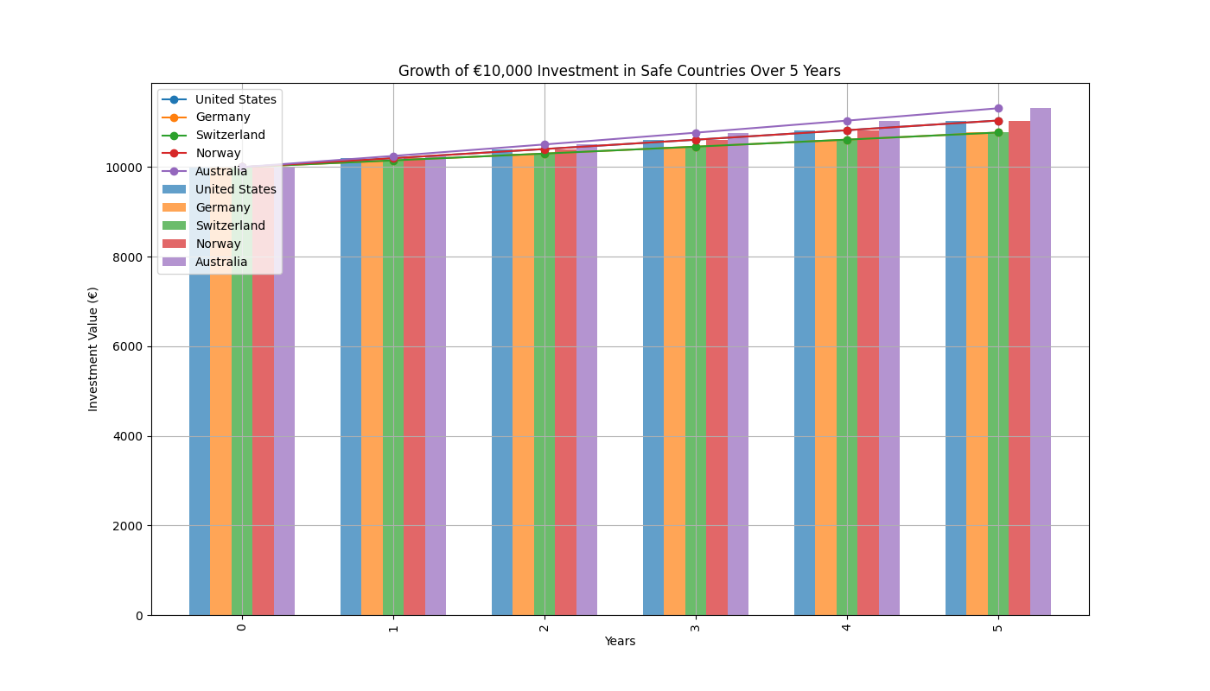
Growth of €10,000 Investment in Safe Countries Over 5 Years

Slide 6
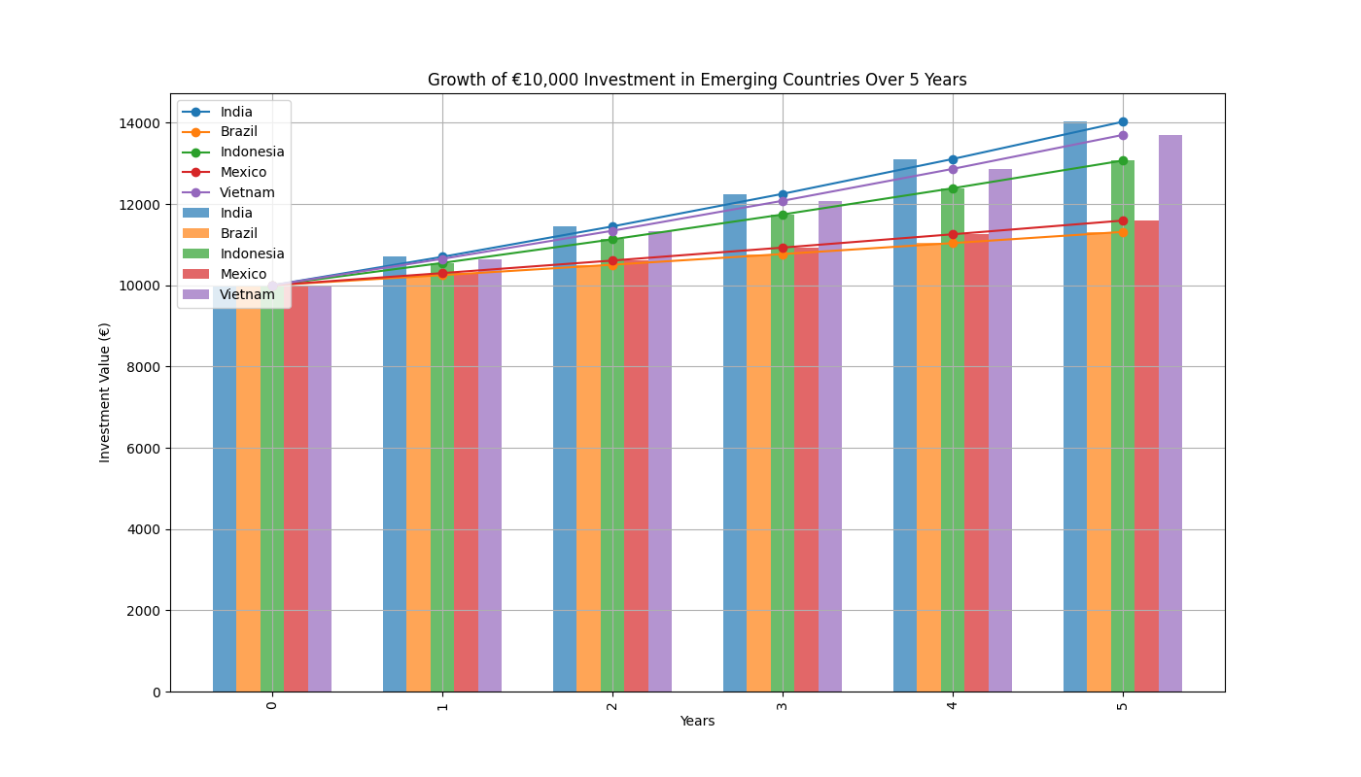
Growth of €10,000 Investment in Emerging Countries Over 5 Years

Slide 7
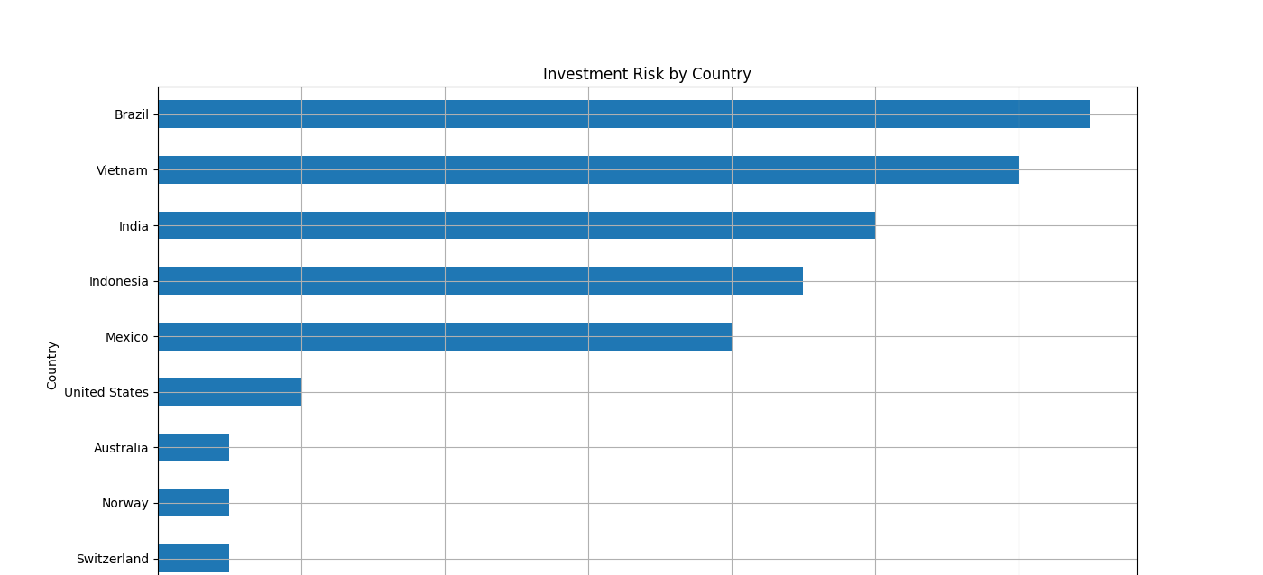
Investment Risk by Country

Slide 8
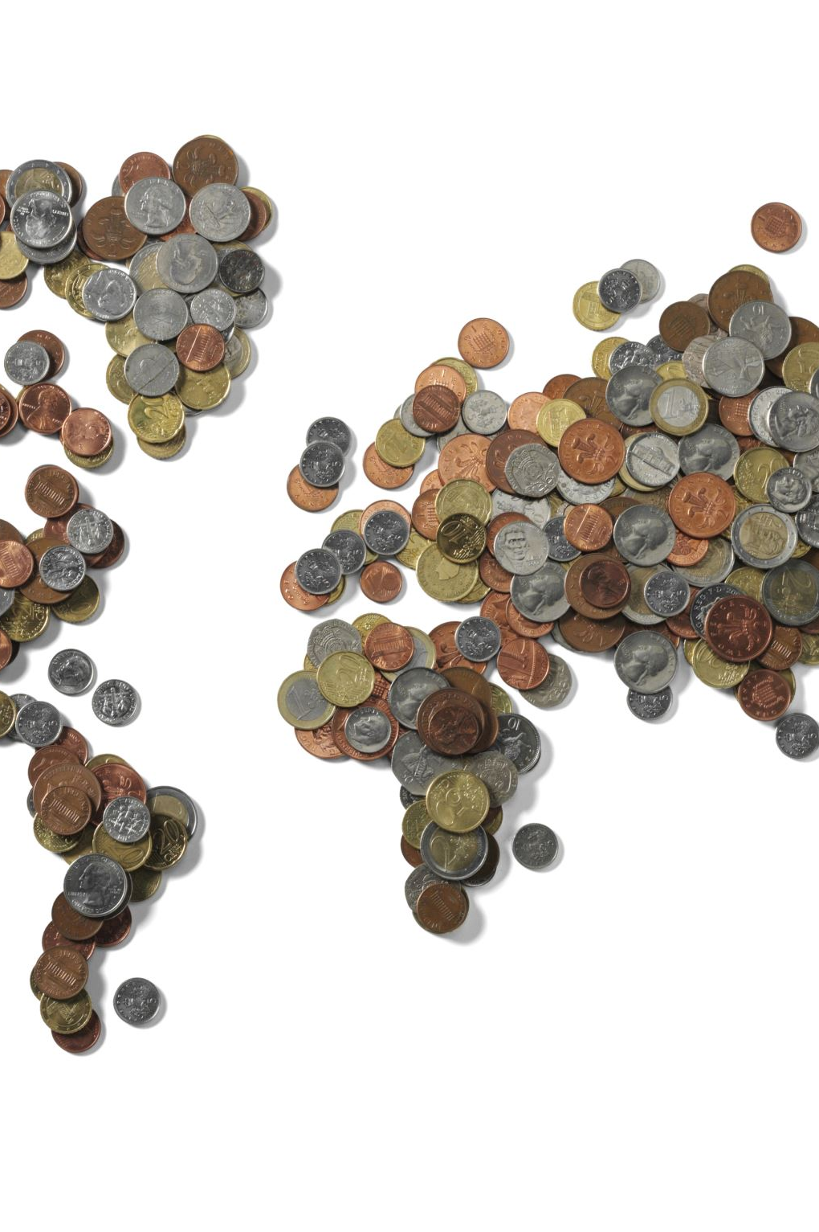
Interpretation
Safe Countries:
- United States: Investment grows to approximately €11,041.
- Germany: Investment grows to approximately €10,772.
- Switzerland: Investment grows to approximately €10,772.
- Norway: Investment grows to approximately €11,041.
- Australia: Investment grows to approximately €11,331.
Emerging Countries:
- India: Investment grows to approximately €14,026.
- Brazil: Investment grows to approximately €11,314.
- Indonesia: Investment grows to approximately €13,071.
- Mexico: Investment grows to approximately €11,593.
- Vietnam: Investment grows to approximately €13,696.

Slide 9
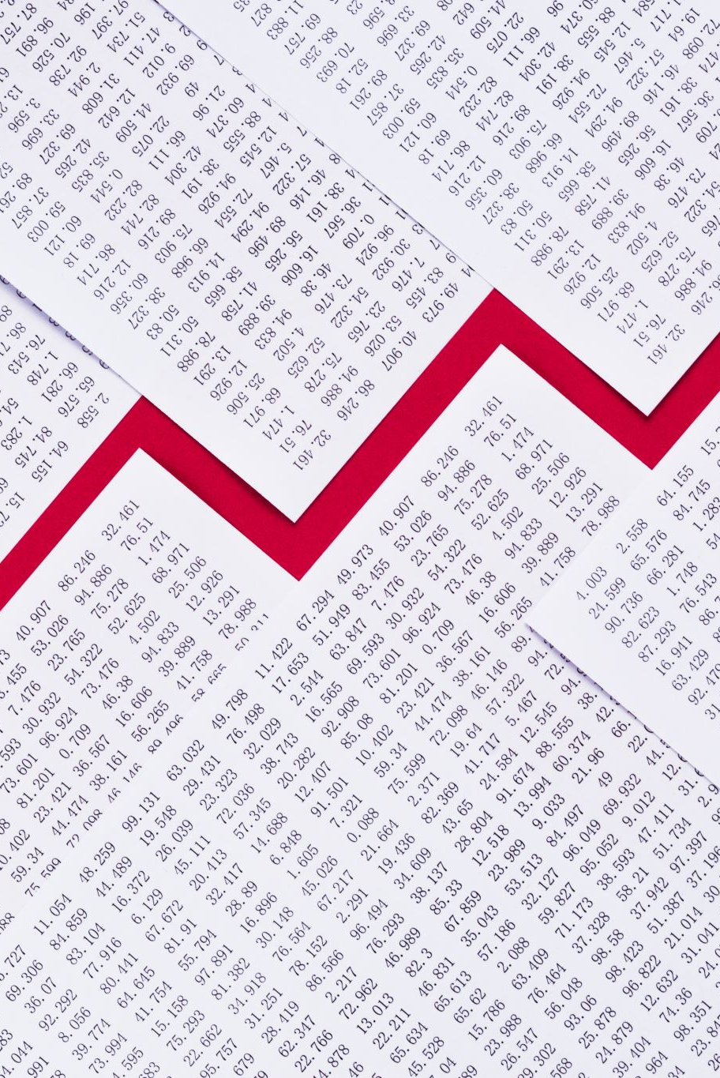
Conclusion
Best Choice for Investment:
Based on the balance of risk and return, Indonesia emerges as the best choice for investment among the given emerging markets. It provides a high expected return with a moderate risk profile:
- Expected Return: €13,071 from a €10,000 investment over 5 years.
- Risk: Rated BBB (9 on our risk scale).
Indonesia's large domestic market, economic reforms, and infrastructure development create a favorable environment for investment. While India and Vietnam offer higher returns, their associated risks are significantly greater. Mexico, while safer, offers lower returns compared to Indonesia.

